Slide 1


In Search of the Small:
Ephemeral Coronal Holes
Rachel O’Connor
Smith College
Heliophysics Science Division, Goddard Space Flight Center
Notes:
I’m Rachel O’Connor, I’m a rising Junior at Smith College, and this summer I returned to work with Dean Pesnell and Michael Kirk on ephemeral coronal holes.

Slide 2
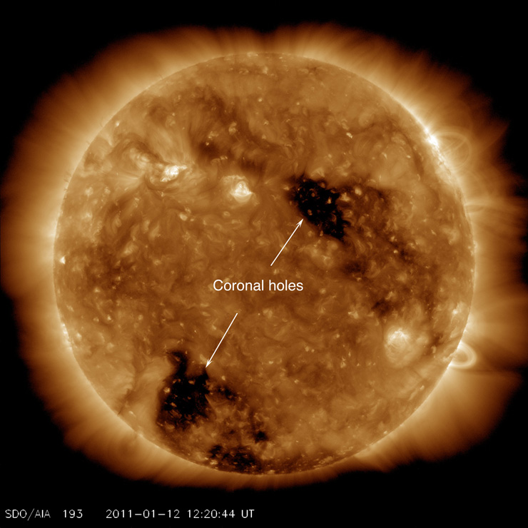
Coronal Holes
Dark, less dense regions
Unipolar magnetic fields
“Open” magnetic field lines
Source of fast solar wind
Polar vs Equatorial: years vs months
Notes:
Before we start talking about ephemeral coronal holes, let’s talk about regular coronal holes. Coronal holes are dark, less dense regions of the Sun’s outer layer-- the corona-- that are caused by unipolar regions of the solar magnetic field. These unipolar regions are caused by magnetic field lines that “open” out into space rather than looping back down to the sun. These open field lines result in big gusts of solar wind. Now, generally, there are two types of coronal holes: equatorial, and polar. Polar coronal holes are very large holes that occur on the poles, and have lifetimes of up to five years. Equatorial coronal holes occur closer to the solar equator, and generally last for a solar rotation or two.

Slide 3
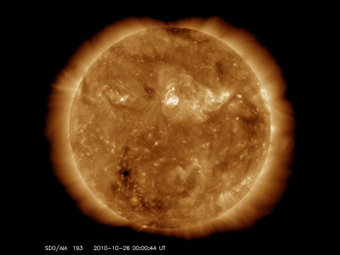
Ephemeral Coronal
Holes
Small
Short
Volatile
Why?
Notes:
In contrast to those types of coronal holes, ephemeral coronal holes are much smaller and much shorter-lived. They also occur around the equator, but their lifetimes are usually between one and two days. This puts a limit on how big they can get, so generally these coronal holes are significantly smaller than equatorial coronal holes. This video here shows an ephemeral coronal hole I studied last summer, and as you can see it forms and disappears within a day. This is very unusual behavior, and attempting to understand these small oddities became the central focus of my project.

Slide 4
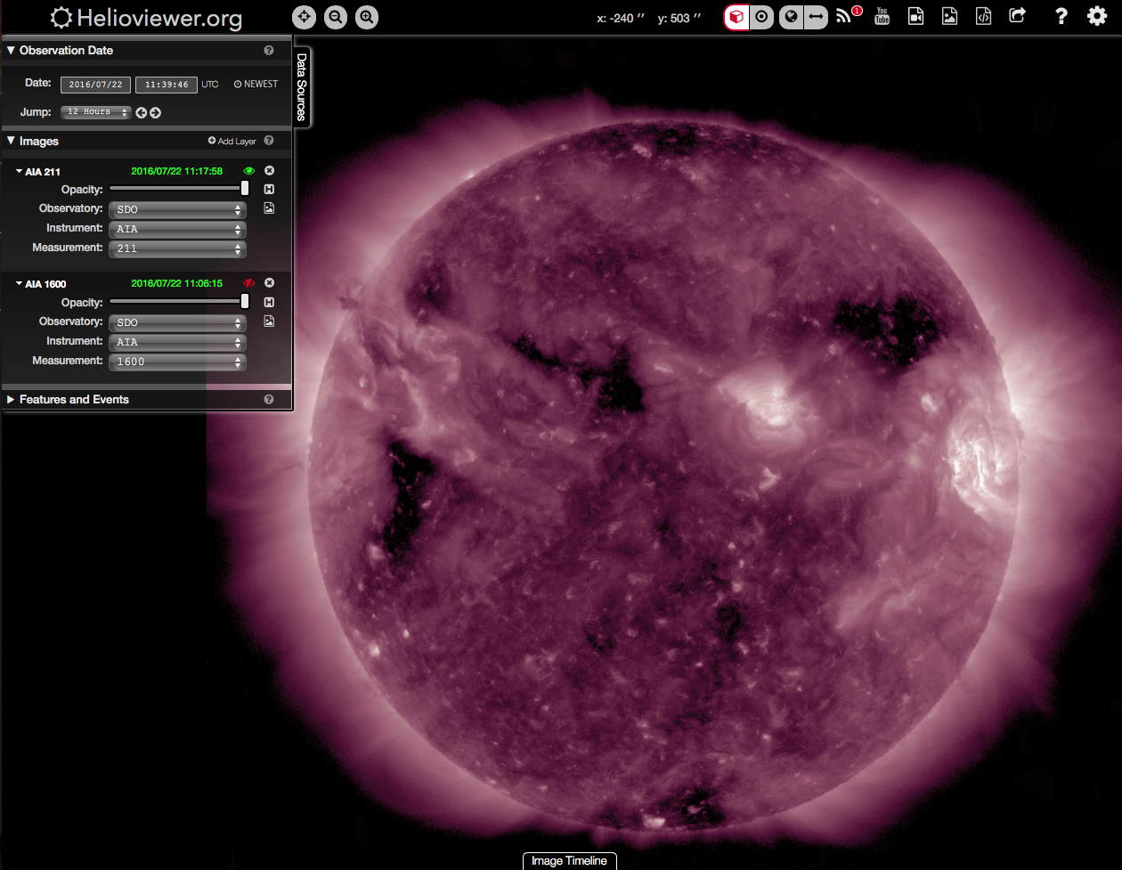
The Search
How many?
June 2010 - June 2016
12 hour cadence, 211 Å
Brief, then intensive
Notes:
In order to study ephemeral coronal holes, it is useful to have some to study. It is also useful to understand how often these events happen, as there are frequently small dark structures on the Sun-- so my task became trying to separate out ephemeral coronal holes from other phenomena. My search for ephemeral coronal holes spanned six years of SDO data on a 12-hour cadence. I used the helioviewer tool, as seen in this image, for this search, and set it to the 211 angstrom band of AIA because smaller coronal holes are slightly easier to see in that band than in the 193 angstrom band. To start, the search was very brief-- just a scan over the whole disk for something small-ish and dark, maybe something that looked similar to the two events already studied.

Slide 5
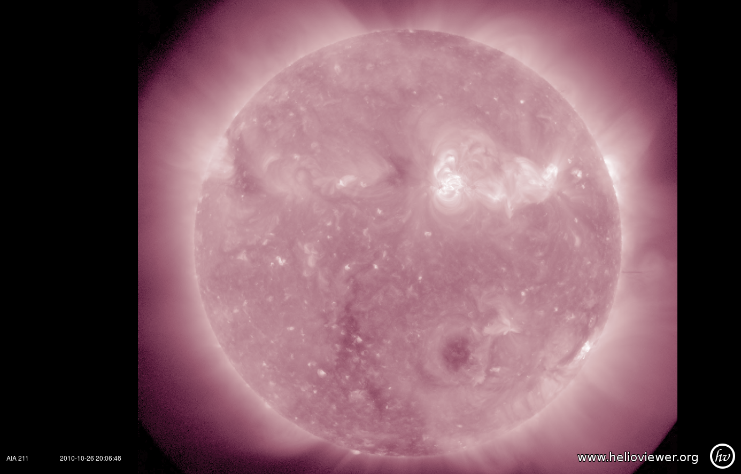
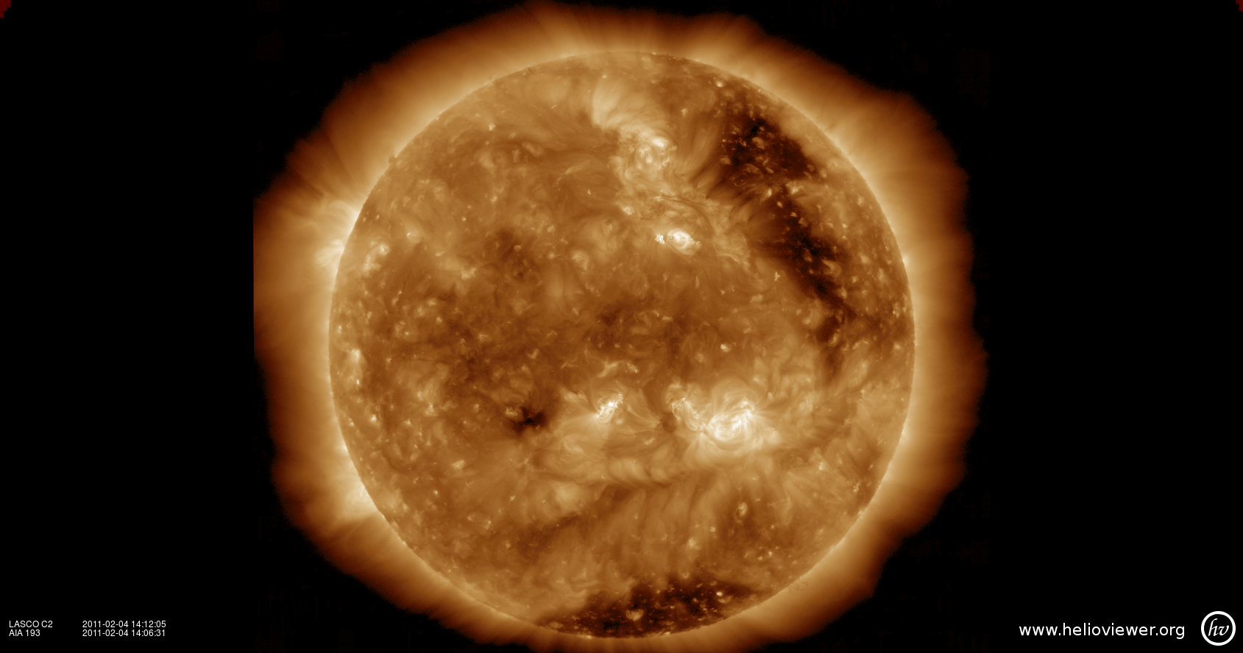
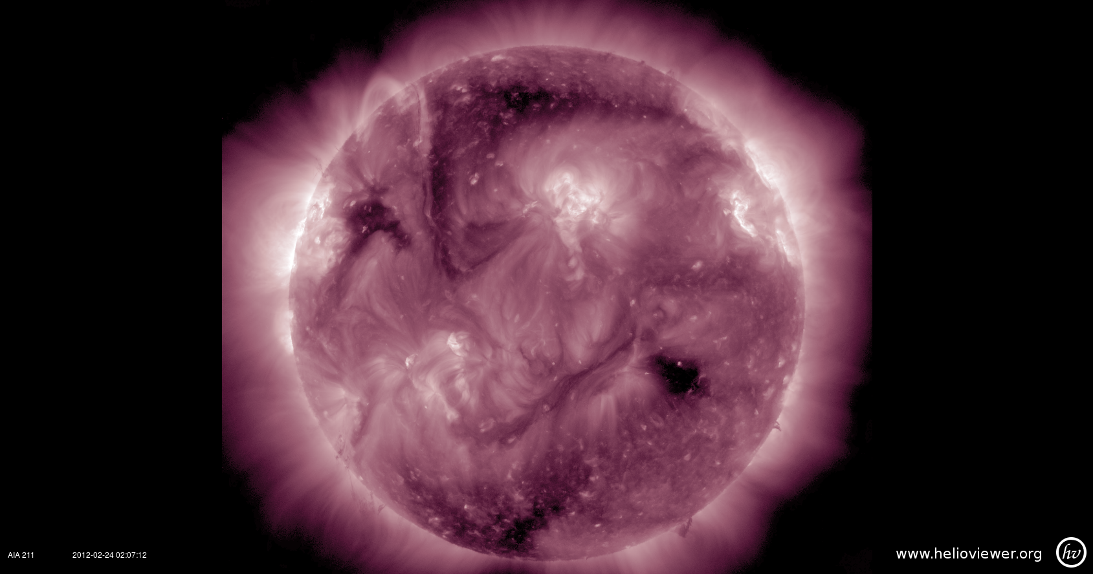
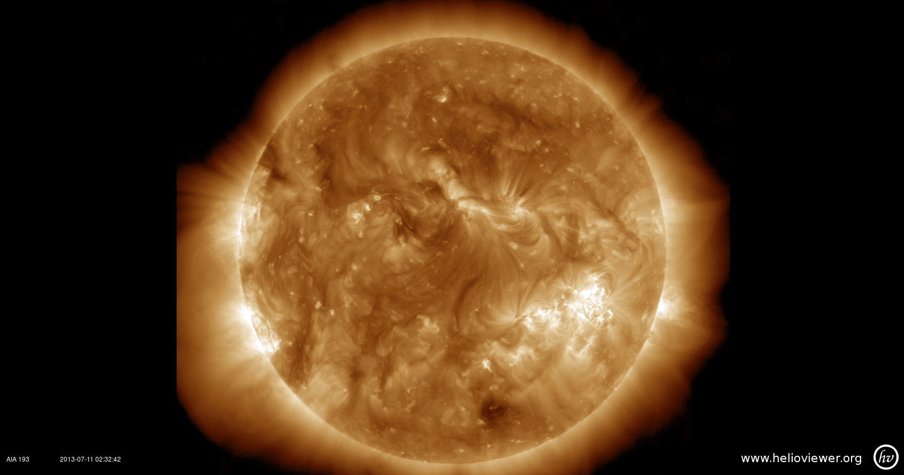
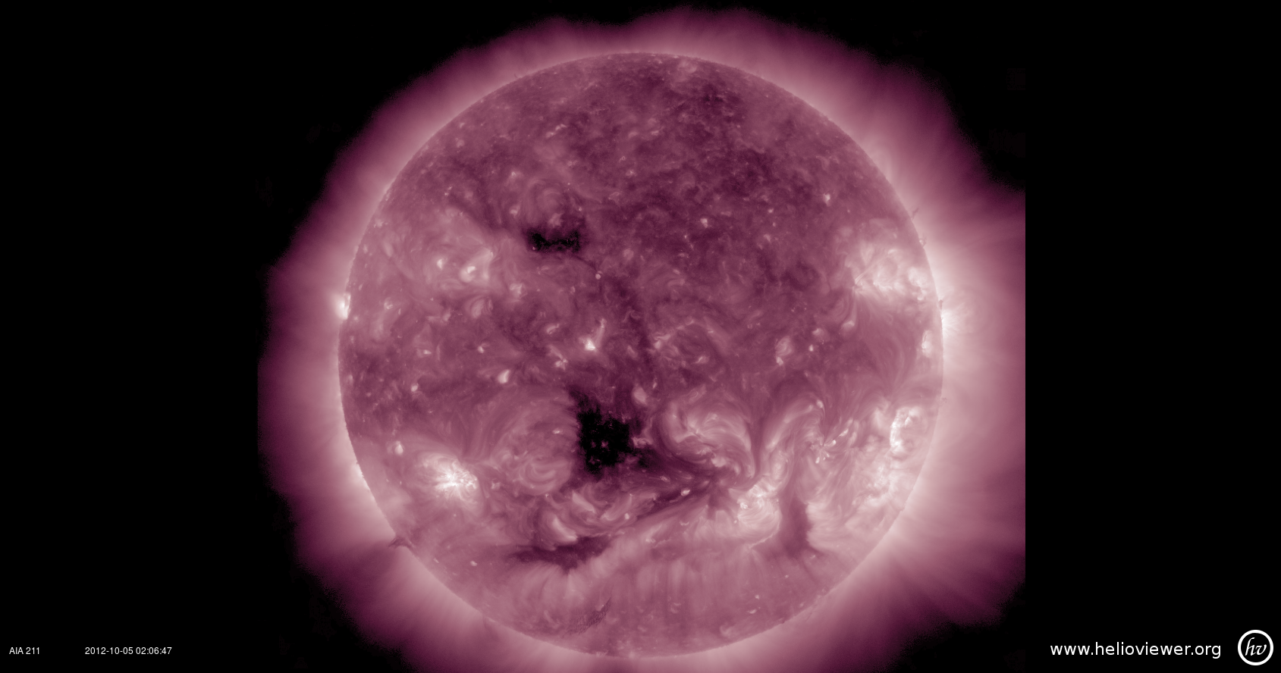
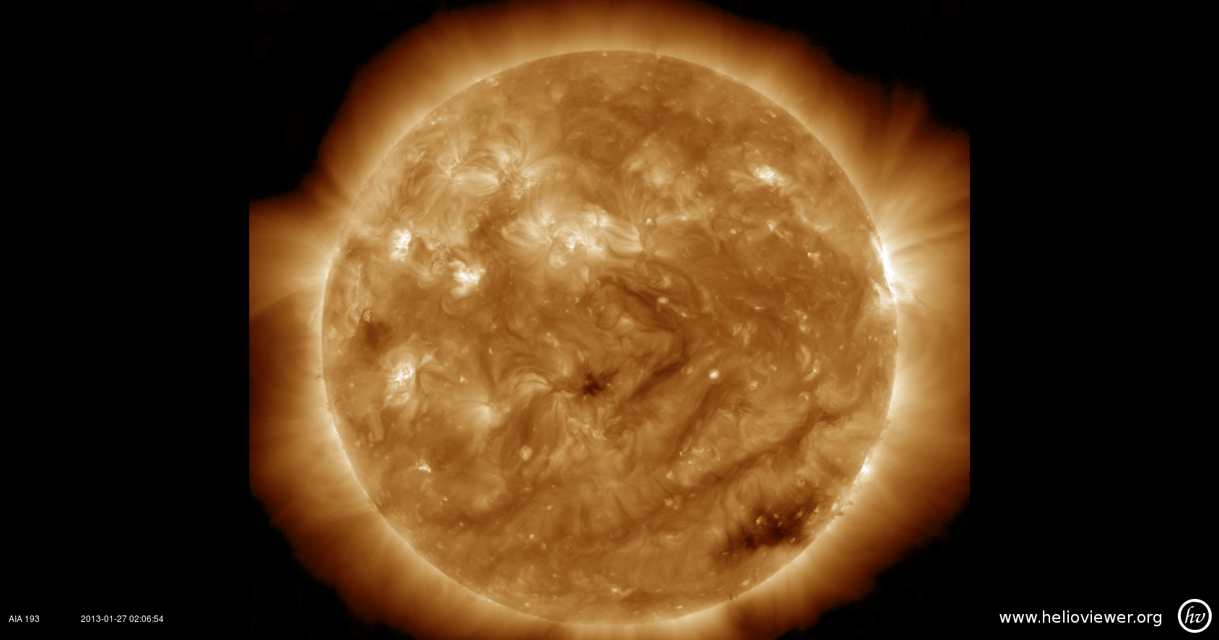
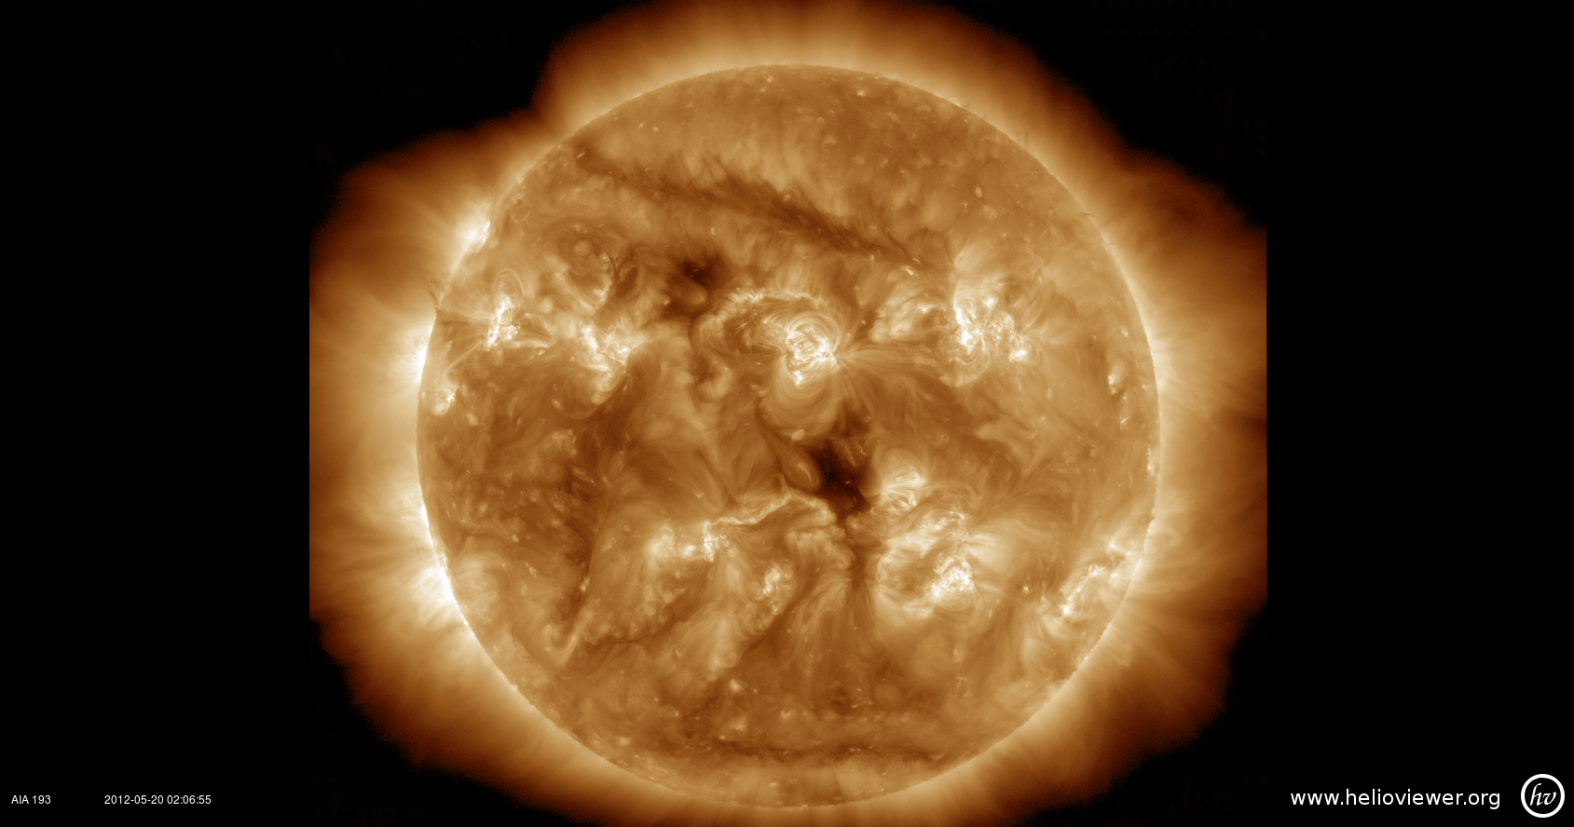
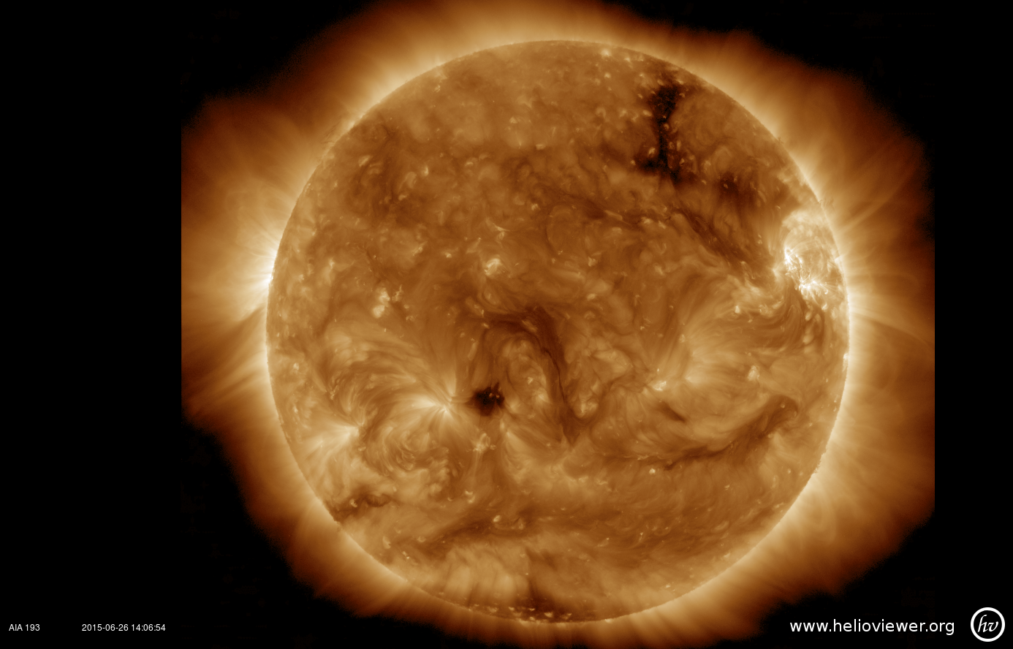
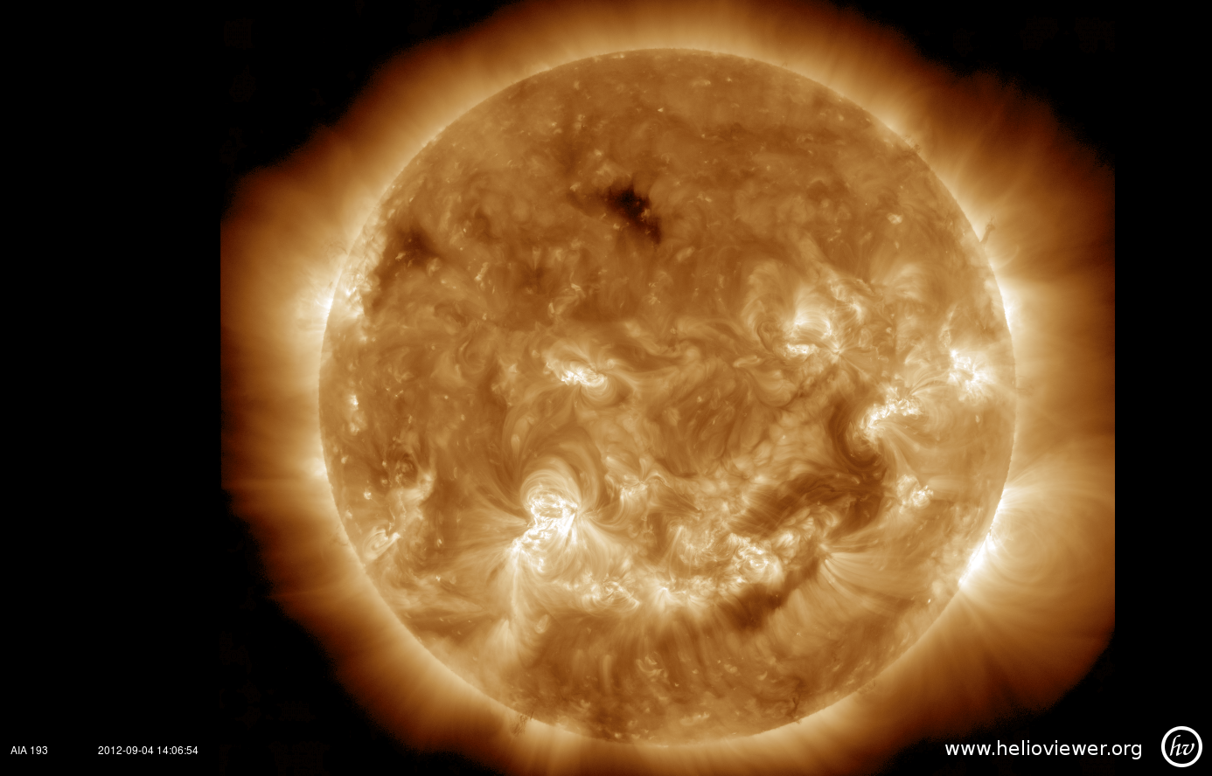
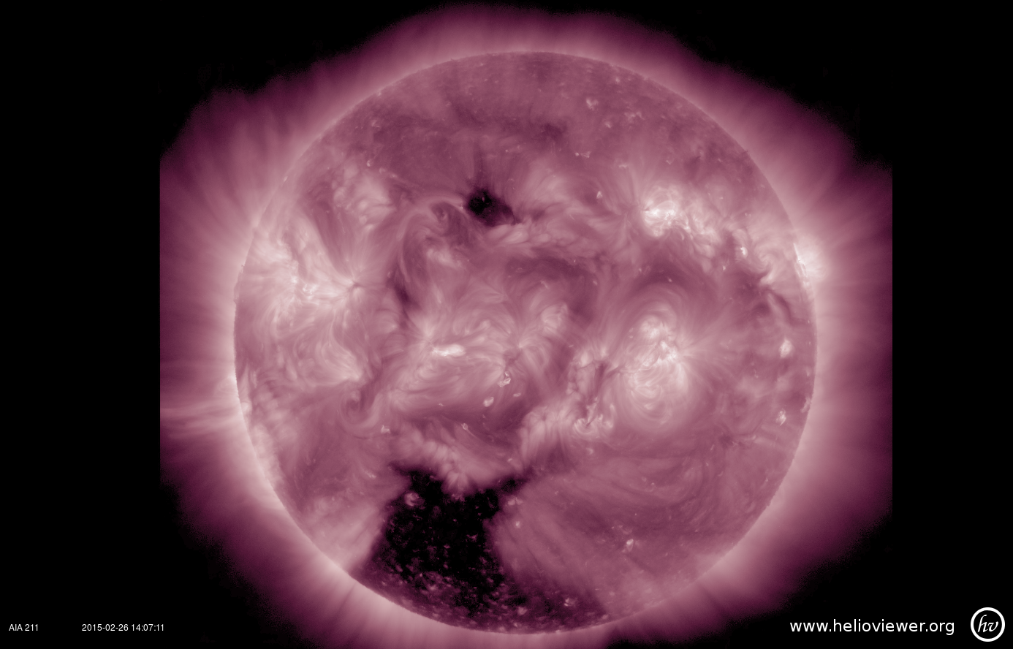
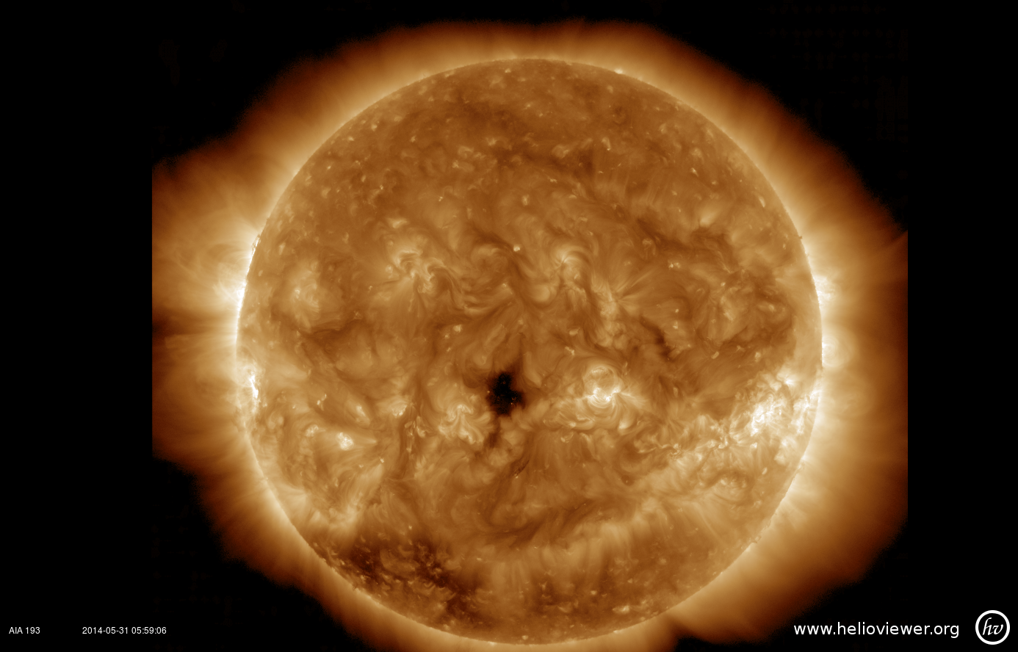
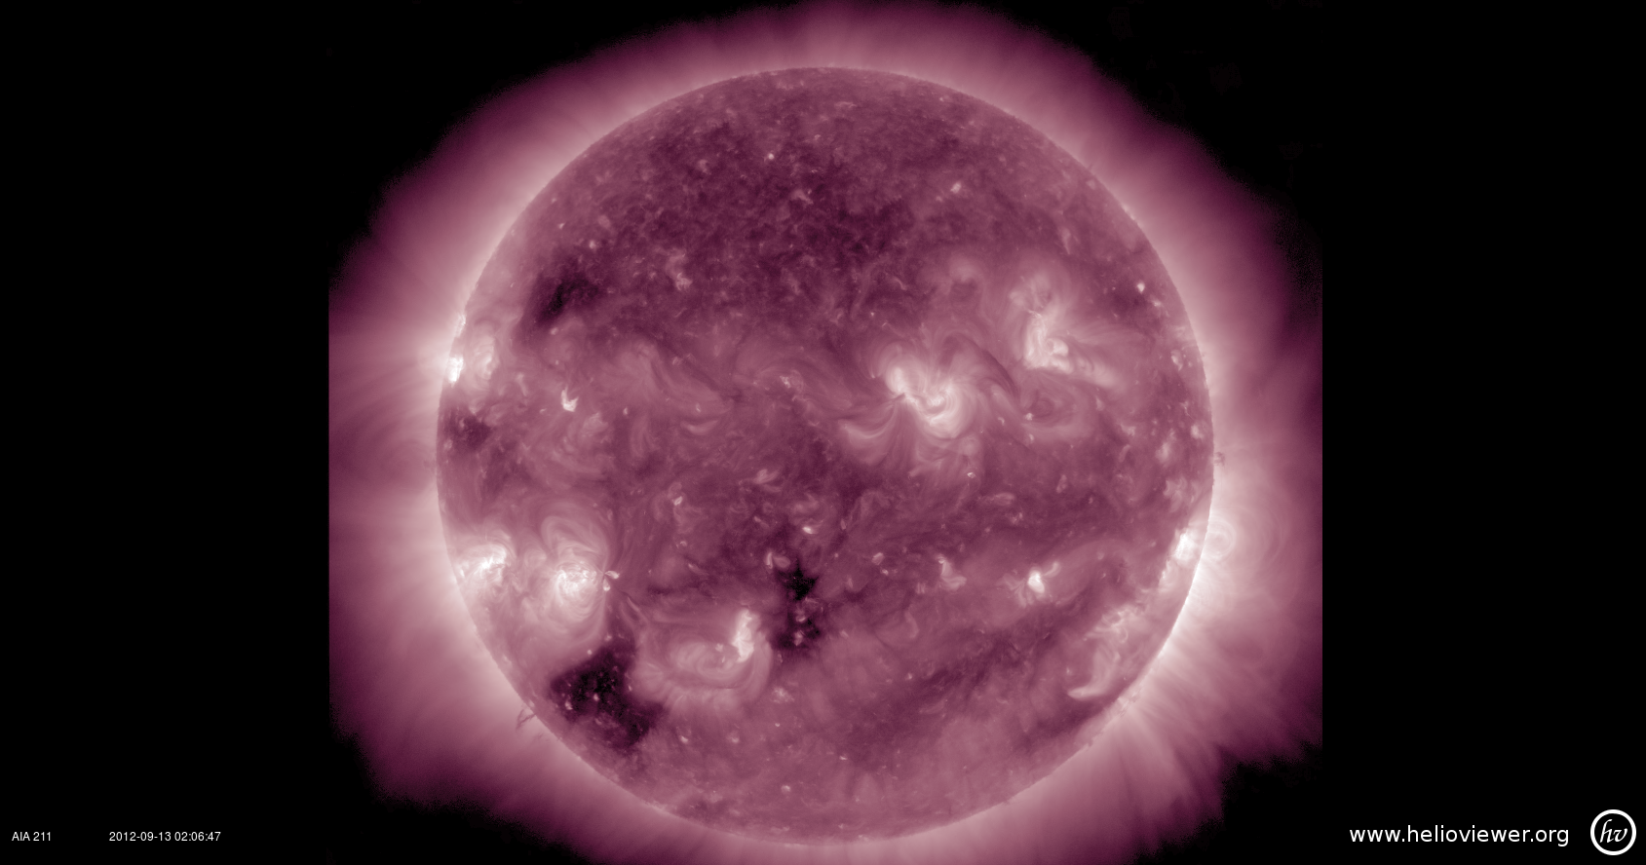
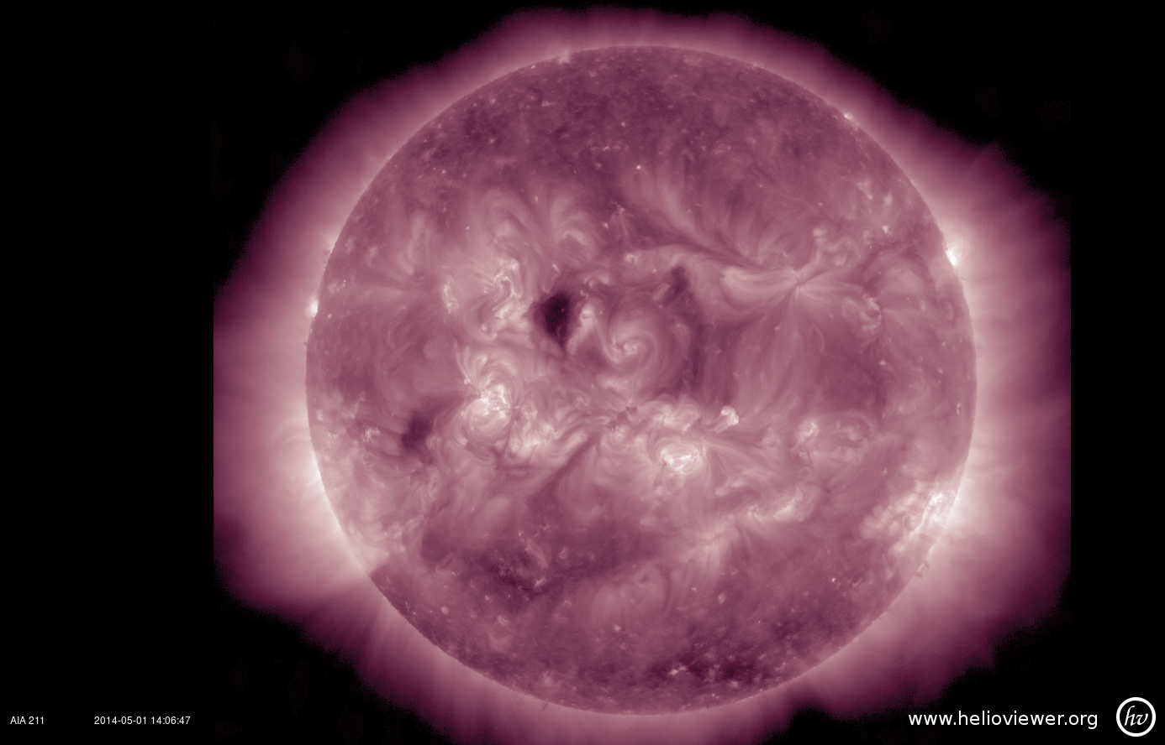
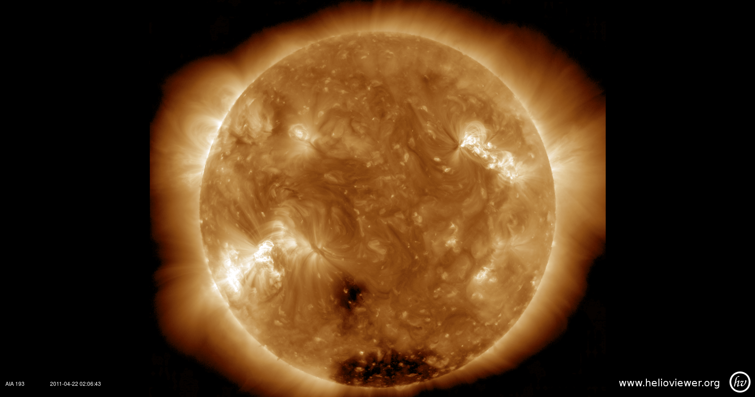
Results:
149
Notes:
This primary search turned up 149 candidates, which were cataloged by their date of central disk crossing. After these candidates were chosen, they were then put through a much more rigorous analysis to determine whether or not they were actually what I was looking for.

Slide 6
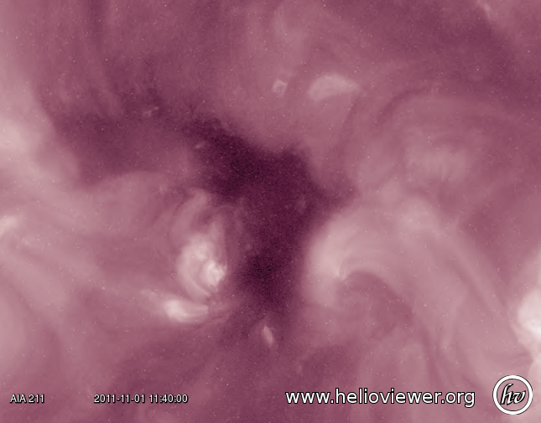
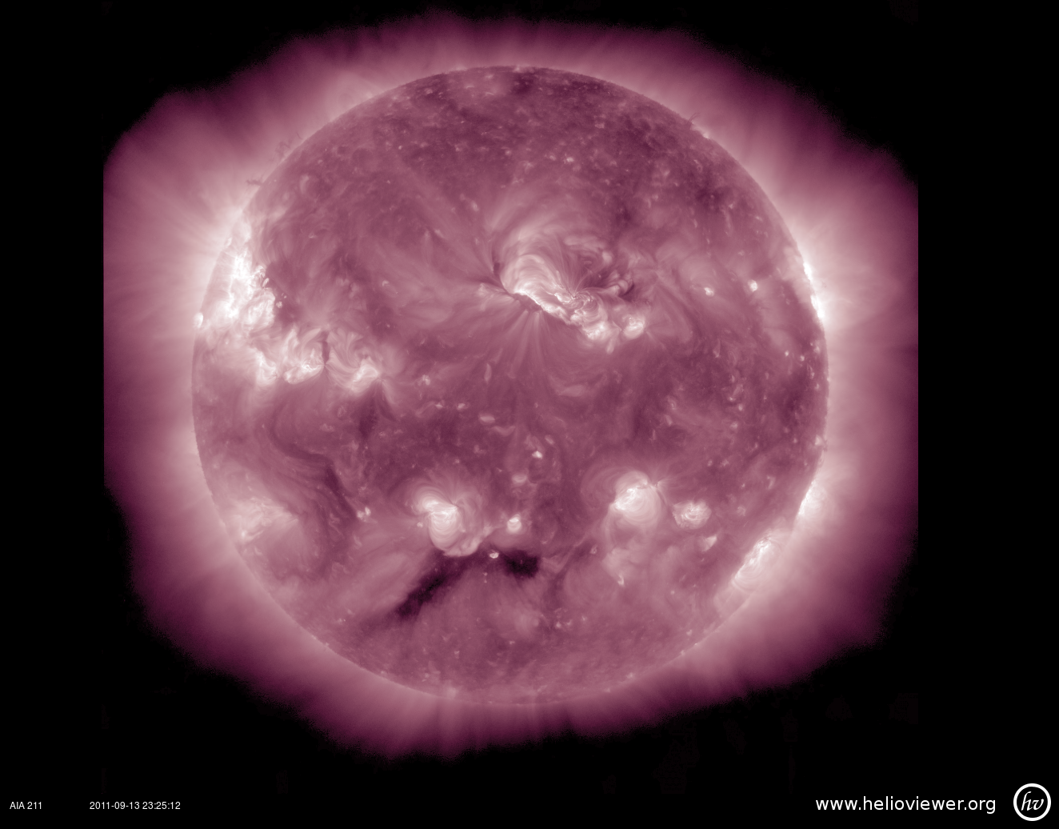
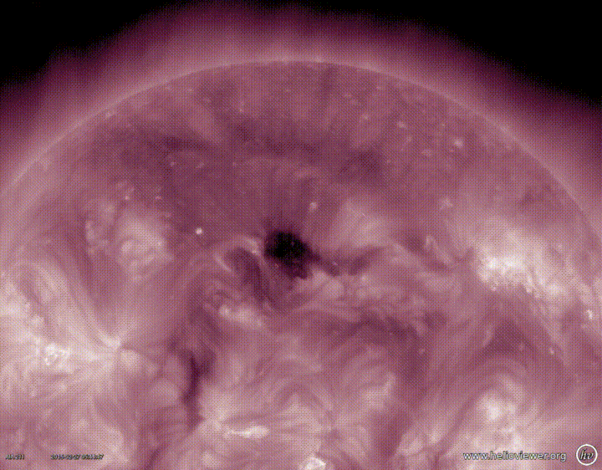
Criteria
Darkness
Isolation
Eruption
Lifetime Length
Notes:
For this part of the search, I created a four-part criteria to define ephemeral coronal holes in the context of this catalog. The first criterion, lifetime length, was more for ease of study than anything else: if the hole showed evidence of forming before it appeared on the disk, or failing to destintegrate before leaving the disk, it was eliminated. This was simply because for this study, lifetime analysis is a very important aspect-- if it can’t be seen, it can’t be studied. The second criterion, darkness, was to prevent things like coronal shadows and other “dark” regions of the corona from being analyzed in this study-- the dark parts had to be “dark enough” to qualify as a coronal hole. The isolation criterion prevented analysis of events that were part of a larger coronal hole structure and had broken off-- like if a tiny piece of this broke off and then disintegrated as it crossed the disk, that’s not an ephemeral coronal hole. Finally, if there was an eruption that closed the hole prematurely, it was generally disqualified.

Slide 7
Notes:
With this criteria in mind, the second analysis was done, and the final number of ephemeral coronal holes that merited further analysis in six years was: six. This is including the two I studied last summer. That’s a really low number, averaging one a year!

Slide 8
Notes:
With this criteria in mind, the second analysis was done, and the final number of ephemeral coronal holes that merited further analysis in six years was: six. This is including the two I studied last summer. That’s a really low number, averaging one a year!

Slide 9
What does this mean?
These events are unique and rare!
More could be found using STEREO-A & B, and other solar satellites
Further research in formation, physical characteristics, etc.
Notes:
So, as this search showed, these events are obviously unique from other small and dark structures on the corona, and they’re also unique in their behaviour when compared with “regular” coronal holes. True ephemeral coronal holes are also extremely rare.

Slide 10
References
Burlaga, L.F., K.L. Harvey; N.R Sheeley, Jr. (2001). A transitory corotating stream, a short-lived coronal hole, and related magnetic fields. Journal of Geophysical Research, 106(A11), 24,915-24,922.
Solodyna, C.V.; A.S. Krieger; J.T. Nolte (1977). Observations of the birth of a small coronal hole. Sol. Phys., 54(123).
Altschuler, M.D.; D.E. Trotter; F.Q. Orrall (1972). Coronal Holes. Sol. Phys., 26(2), 354-365.
Karna, N., J. Zhang, W.D. Pesnell, S.A. Hess Webber (2013). The Study of the cavity’s morphology, density, thermal and magnetic properties from the SDO Observations. American Astronomical Society, 44(100.47).

Slide 11
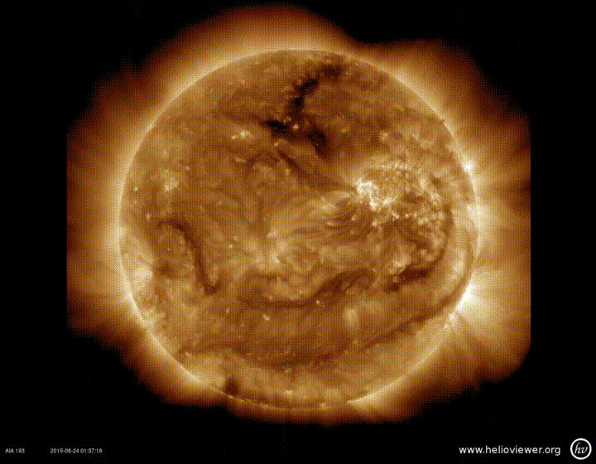
Questions?

